Slide 1

Financial Sector Regulation Act - Implementation
National Treasury presentation to the Standing Committee on Finance
17 April 2018

Slide 2
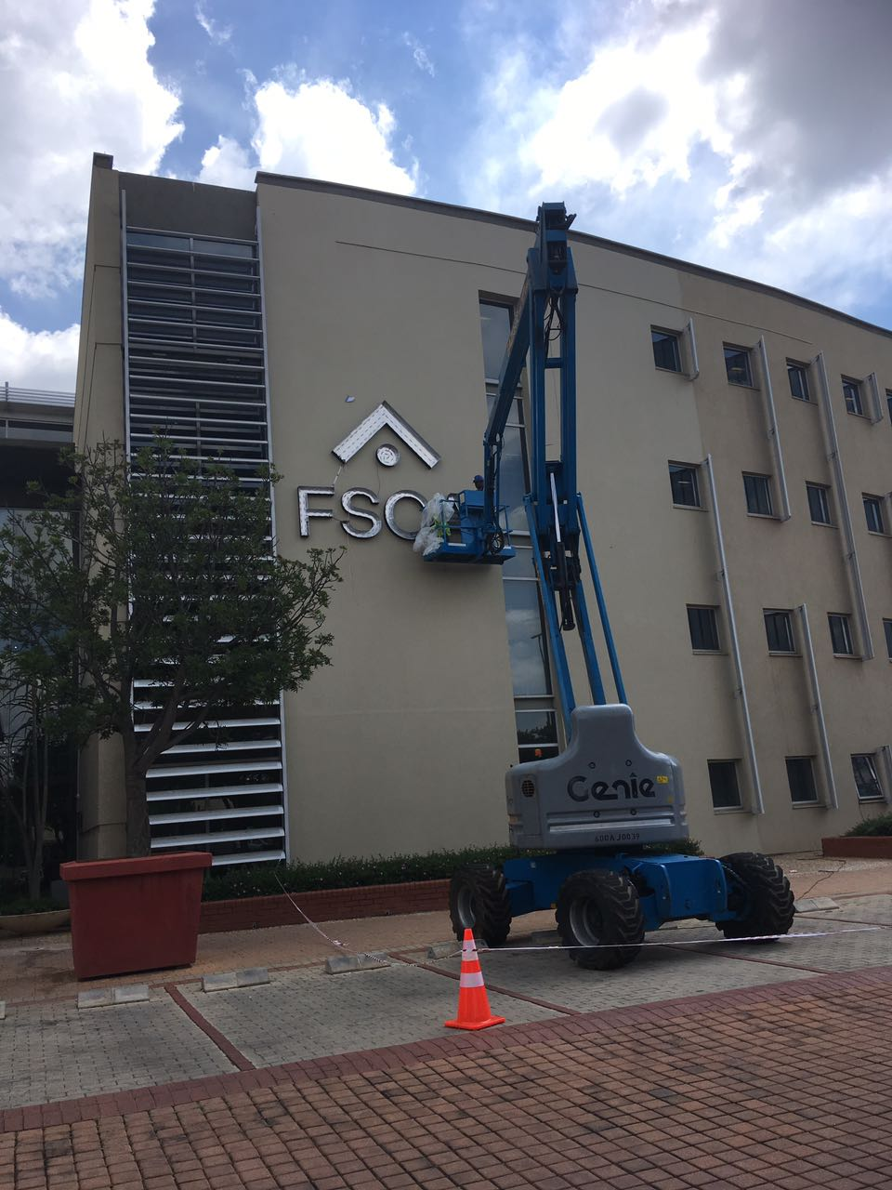

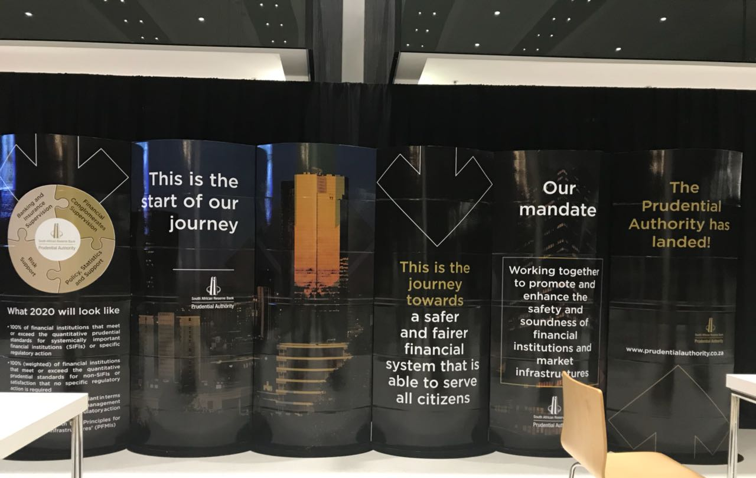
Twin Peaks goes live

Slide 3
Purpose of Regulations
In terms of section 304 of the FSRA, the Minister of Finance may make Regulations that provide for matters that are necessary in order to provide for the appropriate implementation of the FSRA that are not addressed in the Act, and for the establishment of the Prudential Authority and the Financial Sector Conduct Authority (“the financial sector regulators”) and other entities that must be established.
The Regulations are intended to clarify the performance of functions in terms of the Act during the transitional period prior to the establishment of the financial sector regulators.
The Regulations also provide for transitional arrangements until the Financial Services Tribunal (“the Tribunal”) is operational.
The application of certain transitional provisions in the FSRA is clarified.
The intended purpose of the Regulations is to facilitate the smooth implementation of the FSRA, and the establishment of the financial sector regulators and the Tribunal.
  )

Slide 4
Purpose of Regulations (2)
The Minister of Finance is required to make Regulations in terms of section 61(4) of the FSRA, to provide a process for the selection of persons for the appointment of the Commissioner and Deputy Commissioners of the Financial Sector Conduct Authority.
The Regulations provide for the advertising of the positions, and for the establishment of panels to consider, short-list, interview, and recommend candidates for appointment to the Minister of Finance.
The intended effect of the Regulations is to provide for a fair and transparent process for the appointment of the Commissioner and Deputy Commissioners of the Financial Sector Conduct Authority.
  )

Slide 5
Process
On 18 December 2017, draft Regulations were published on the National Treasury website for comment, and a Notice of that publication was published in the Government Gazette.
The required six week period for public comment was completed on 31 January 2018.
Prior to finalising and promulgating the Regulations in the Government Gazette, the draft Regulations must be submitted to Parliament for consideration, for a period of at least 30 days while Parliament is in session.
The following was submitted to Parliament on 15 February 2018:
  Draft regulations and other documents (see slide 5)
  Comments on the draft regulations, with indication of National Treasury’s response
Regulations need to be promulgated prior to the establishment of the Prudential Authority, Financial Sector Conduct Authority, and the Financial Services Tribunal on 1 April 2018.
The final Regulations and Commencement Notice were published on 29 March 2018
  )

Slide 6
Documents circulated to the Standing Committee of Finance (as required in terms of s 288(4) of the FSRA)
  Draft Regulations published for public comment in December 2017
  A statement explaining the need for and the intended operation of the Regulations and the version of draft Regulations that were published for public comment in December 2017
  A statement of the expected impact of the Regulations and Impact Assessment for the Financial Sector Regulation Bill
  Notice published in the Government Gazette inviting submissions in relation to the Regulations and stating where, how and by when submissions are to be made
  A report of the consultation process which includes-
  a general account of the issues raised in the submissions; and
  a response to the issues raised in the submissions.
Notes:
087 8250143
399709

Slide 7
Summary of Regulations
Regulation 1 provides for certain necessary definitions in the Regulations.
Part 1 of the Regulations addresses necessary transitional measures.
Part 2 of the Regulations addresses the appointment of the Commissioner and Deputy Commissioners of the Financial Sector Conduct Authority.

Slide 8
Part 1- Transitional Measures: Regulation 2
Regulation 2 addresses the issue of who would exercise powers if provisions of the Financial Sector Regulation Act come into operation prior to the establishment of the Prudential Authority (“PA”) and the Financial Sector Conduct Authority (“the FSCA”) (collectively, “the financial sector regulators”)
Regulation 2(1)- if any provisions of the FSRA come into operation prior to the PA being established—
  a reference in a financial sector law, other than the Financial Markets Act, to the ‘Prudential Authority’, or a reference to ‘a financial sector regulator’, must be read as referring to or as including a reference to the Reserve Bank;
  the Reserve Bank must perform the functions of the Prudential Authority as set out in section 34 of the Act;
  in respect of the Financial Markets Act, section 1A of that Act applies (which designates the exercise of powers in terms of that Act).

Slide 9
Part 1- Regulation 2 (Cont.)
Regulation 2(2)- if any provisions of the Act come into operation prior to the establishment of the Financial Sector Conduct Authority—
  a reference in a financial sector law to the ‘Financial Sector Conduct Authority’, or a reference to ‘a financial sector regulator’, must be read as referring to or as including a reference to the Financial Services Board;
  the executive of the Financial Services Board, referred to in section 9 of the Financial Services Board Act, must perform the functions of the Financial Sector Conduct Authority in terms of the Act;
  the executive officer of the Financial Services Board, referred to in section 1 of the Financial Services Board Act, must perform the functions of the Financial Sector Conduct Authority in terms of legislation referred to in paragraph (b), (c) or (d) of the definition of a financial sector law in section 1(1) of the Act, subject to a delegation under section 20(3) or (3A) of the Financial Services Board Act;
  in respect of the Financial Markets Act, section 1A of that Act applies.

Slide 10
Part 1- Regulation 2 (Cont.)
Regulation 2(3)- If the Financial Sector Conduct Authority is established prior to the Fees and Levies Chapter, Chapter 16, comes into effect, a reference to the board in sections 15A and 16 of the Financial Services Board Act must be read as a reference to the Financial Sector Conduct Authority.
This is to make it clear that the Financial Sector Conduct Authority could continue to be funded for an interim period in accordance with the Financial Services Board Act until the forthcoming Financial Sector Levies Bill is enacted.
Only one minor revision was proposed for this Regulation to promote clarity (regulation 2(1)(b) - a clause reference was added).

Slide 11
Part 1- Regulation 3
Regulation 3 deals with the management of the transitional process to establish the FSCA.
Original drafting: Regulation 3(1): If Chapter 4 of the Act comes into effect before the appointment of the Commissioner and Deputy Commissioners, the executive of the FSB referred to in section 9 of the FSB Act, acting under the oversight of the Financial Services Board, must perform the functions of the Executive Committee of the FSCA, to facilitate the disestablishment of the FSB and the establishment of the FSCA in an efficient and effective manner with the least disruption, until the persons appointed as the Commissioner and Deputy Commissioners have commenced service.
Revised drafting: Concern was raised that the original drafting did not directly provide for a Commissioner; the FSR Act provides that certain functions are performed by a Commissioner and clarity was requested as to who that would be in the interim period.
To minimise potential conflicts of interest in the appointment process for the new Commissioner and Deputy Commissioners, the revised draft provides for a ‘transitional management committee’, still comprised of the ExCo of the FSB. The chair of the Board of the FSB is designated to act as Commissioner. An independent candidate (external to the FSB) is also included to ensure a transparent transitional process.

Slide 12
Part 1- Regulation 3 (Cont.)
Regulation 3(2) sets out the functions that the executive of the Financial Services Board could perform while acting as the Executive Committee of the Financial Sector Conduct Authority.
Regulation 3(3) addresses how funding will be handled during the transitional period of the establishment of the FSCA.
Regulation 3(4) has been slightly amended for clarity in providing that the board of the FSB will remain in place until 30 Nov to ensure that the annual report of the FSB is tabled in line with legal requirements. It also provides for the members of the transitional management committee to remain in an advisory capacity once the Commissioner and Deputy Commissioner have been appointed (3 months).
Regulation 3(5) addresses how the reporting of financial statements will be handled during the transitional period.

Slide 13
Part 1- Regulation 4
Regulation 4 addresses the establishment of the Financial Services Tribunal
Regulation 4(1) provides that the FSB/FSCA must provide the necessary initial secretarial, administrative and other support for the Tribunal, and an agreement will be entered into between the FSCA and the PA to provide for the sharing of costs, until 1 April 2019, when the Financial Sector Levies Bill, once enacted, would raise levies for the functioning of the Tribunal. The Financial Intelligence Centre has now also been included as the Tribunal will hear appeals in relation to the FIC
Regulation 4(2) addresses what rules, regulations, guidelines, etc., would be applied by the Tribunal to handle cases during the period from its establishment on 1 April 2018, until the Chairperson of the Tribunal may designate Tribunal Rules.
During this period, either the existing rules, regulations, etc., of the existing Appeal Board of the FSB and the Board of Review in terms of the Banks Act could be jointly designated by the existing Chairpersons of the Board of Review and Appeal Board as being applicable, or, if no designation is made prior to the Tribunal being established on 1 April, the existing Appeal Board rules and regulations, etc., would be applied.

Slide 14
Part 1- Regulations 5 and 6
Regulation 5 deals with how documents that are required to be published on the Register must be published prior to the Register being established, as the Register cannot be established immediately.
Regulation 6 clarifies the appropriate interpretation of certain provisions in the Act, due to the fact that those sections refer to “Chapter”, “Part” or ‘’section”, and it will be necessary to bring different provisions of the Chapter, Part and section referred to into operation at different times, and so there would not be a single date on which the “Chapter”, “Part” or “section” referred to would come into operation.

Slide 15
Part 2- Appointment of Commissioner and Deputy Commissioners of Financial Sector Conduct Authority
Regulation 7 addresses advertising of the positions of Commissioner and Deputy Commissioner. Minor refinement to the wording made.
Regulation 8 sets out requirements for applications for the positions. Minor typographical correction made.
Regulation 9 provides for the establishment of a Shortlisting panel for the vetting of applications and the shortlisting of candidates, and sets out certain requirements relating to its functioning.
In response to comments that some specification of expertise for the panel should be indicated, the following revised wording for subregulation (2) was made:

Slide 16
Part 2- Regulation 9 (cont)
The Shortlisting Panel for the Commissioner and Deputy Commission consists of—
(i) the Director-General or a Deputy Director-General of the National Treasury nominated by the Director-General as chairperson;
(ii) a Deputy Governor of the Reserve Bank nominated by the Governor;
(iii) the Commissioner of the National Consumer Commission appointed in terms of section 87 of the Consumer Protection Act, 2008 (Act No. 68 of 2008), or that Commissioner’s nominee;
(iv) a representative of the Ethics Institute of South Africa or the Institute of Directors in Southern Africa or any other body that focuses on ethics and good governance in the financial sector, designated by the Director-General of the National Treasury; and
(v) one person designated by the Minister who has suitable experience and expertise in the financial sector, and knowledge of the financial sector, that enables them to appropriately consider and assess the suitability of applicants for appointment as Commissioner or Deputy Commissioner.
(b) The Shortlisting Panel for the first appointments of the Commissioner and Deputy Commissioners must include the Chairperson of the Financial Services Board.
Other minor wording refinements made to subregulations (5) and (6).

Slide 17
Part 2- Regulation 10
Regulation 10 provides for the appointment of a Ministerial Panel to interview shortlisted candidates and recommend a preferred candidate for appointment to the positions of Commissioner and Deputy Commissioner.
Similar comments were received as were made in relation to Regulation 9, and so similar amendments are proposed to regulation 10(1) as are proposed to regulation 9(2), with the Ministerial Panel consisting of:
(a) the Minister as Chairperson;
(b) the Director-General;
(c) the Governor or a Deputy Governor of the Reserve Bank nominated by the Governor; and
(d) one other person designated by the Minister who has suitable experience and expertise in the financial sector, and knowledge of the financial sector, that enables them to appropriately consider and assess the suitability of applicants for appointment as Commissioner or Deputy Commissioner.

Slide 18
Part 2- Regulation 11 and 12
Regulation 11 sets out criteria for candidates to be suitable for shortlisting and interviewing and appointment as Commissioner and Deputy Commissioners, in addition to what is provided in section 61 of the FSRA.
  These criteria are intended to ensure that strongly qualified candidates, with a range of appropriate expertise and experience, are appointed to these critical positions in the FSCA. Required years of experience amended from 7 years to 10 years
Regulation 12 provides for the short title and commencement, and the regulations need to come into operation prior to 1 April 2018.

